Slide 1
Theories of Neural Networks – part 1
Prof. Yong Won SEO, Ph.D.
College of Business and Economics
Chung-Ang University

Slide 2

Simple Linear Regression : Revisited
Given with real (x, y) data, find best a, b for:
$$\hat{y}=ax+b$$
adCost | sales
30 | 120
20 | 60
50 | 140
40 | 100
10 | 70

Slide 3
Minimize sum of squares of deviations

Slide 4
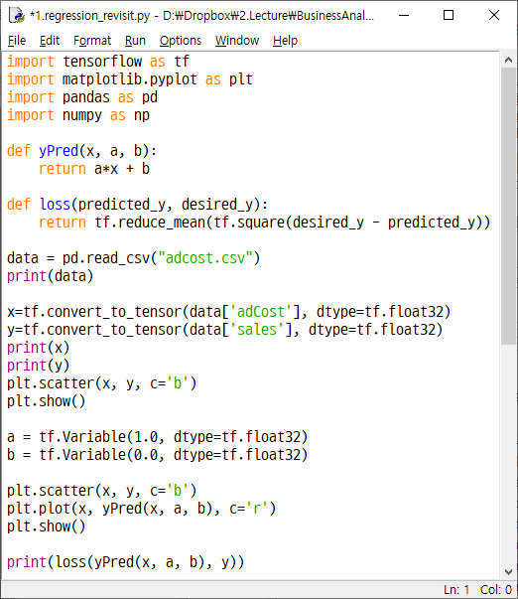
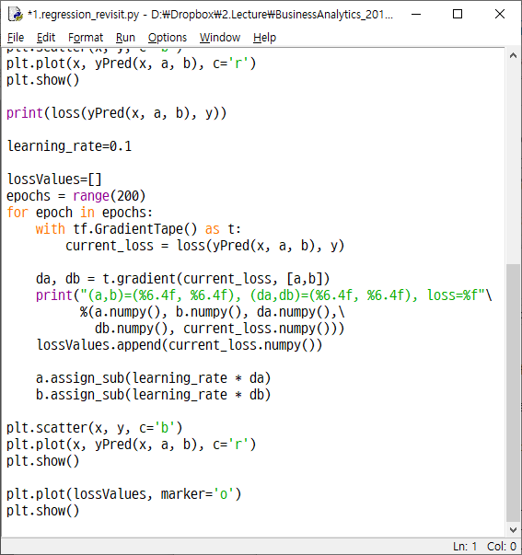

Slide 5





Schematic diagram of simple regression
$$x$$
$$w$$
$$Σ$$
$$\hat{y}$$
$$b$$

Slide 6

Schematic diagram of simple regression
$$x$$
$$w$$
$$Σ$$
$$\hat{y}$$
Loss
$$y$$
$$b$$

Slide 7
Schematic diagram of simple regression
Gradient
$$x$$
$$w$$
$$Σ$$
$$\hat{y}$$
Loss
$$y$$
$$b$$

Slide 8
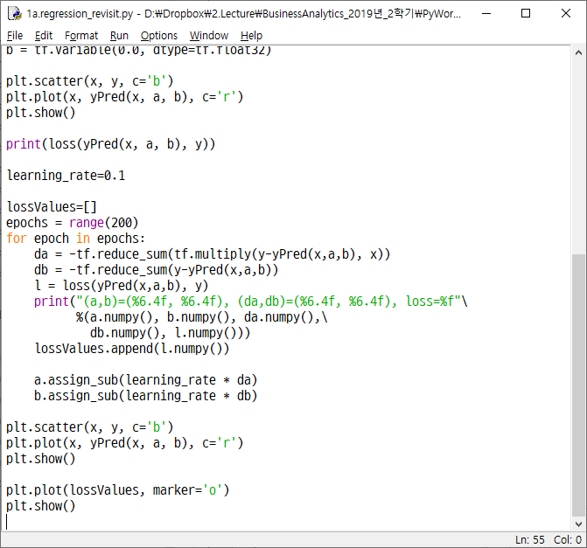

Slide 9
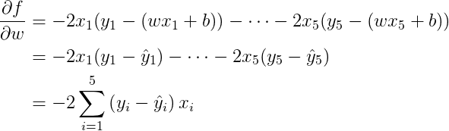
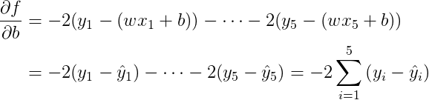


Some maths …
$$loss=f(w,b)=\sum_{i=1}^{5}{{\left(y−\hat{y_{i}}\right)}^{2}=\sum_{i=1}^{5}{{\left(y_{i}−(wx_{i}+b)\right)}^{2}}}$$
$$={\left(y_{1}−(wx_{1}+b)\right)}^{2}+⋯+{\left(y_{5}−(wx_{5}+b)\right)}^{2}$$

Slide 10
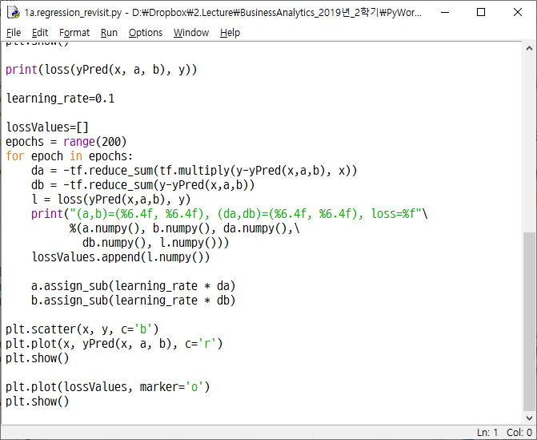

Slide 11
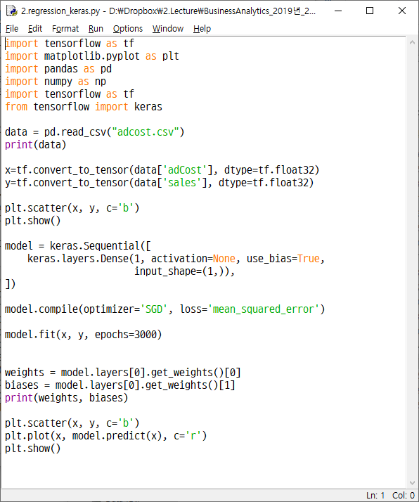

Slide 12
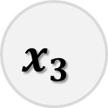

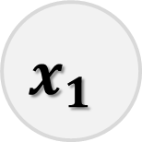
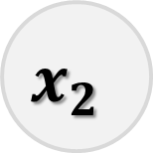





Multiple regression
$$x_{1}$$
$$w_{1}$$
$$x_{2}$$
$$w_{2}$$
$$Σ$$
$$\hat{y}$$
$$w_{3}$$
$$x_{3}$$
…
$$b$$

Slide 13
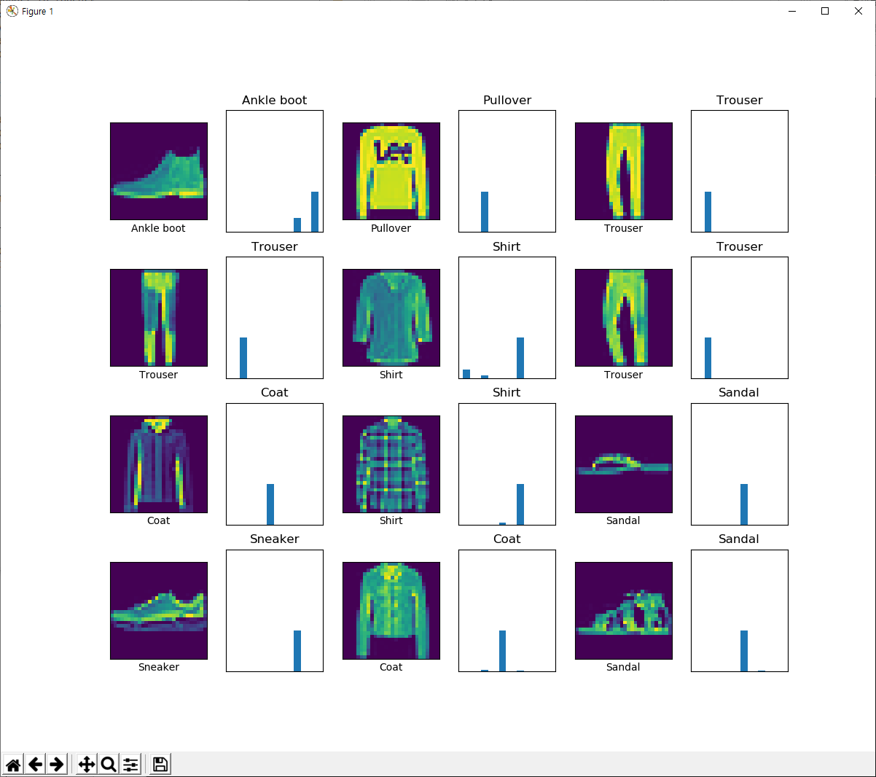

Slide 14
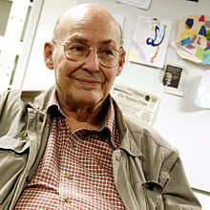
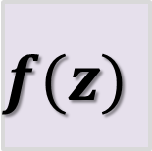
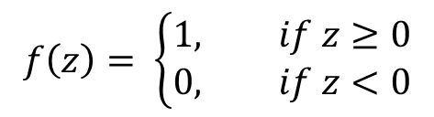


Perceptron (Rosenblatt, 1957)
$$x_{1}$$
$$w_{1}$$
$$x_{2}$$
$$w_{2}$$
$$Σ$$
$$z$$
$$f(z)$$
$$\hat{y}$$
$$w_{3}$$
$$x_{3}$$
No way to fit XOR
…
$$f\left(z\right)= \left\{\begin{aligned}1, if z≥0 \\ 0, if z<0\end{aligned}\right.$$
$$b$$

Slide 15




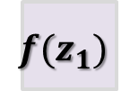



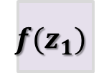

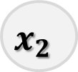





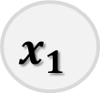

Multilayer Perceptron
No way to train
$$b_{1}$$
$$x_{1}$$
$$w_{11}$$
$$w_{12}$$
$$Σ$$
$$z_{1}$$
$${f(z}_{1})$$
$$Σ$$
$$z_{1}$$
$${f(z}_{1})$$
$$\hat{y}$$
$$w_{21}$$
$$Σ$$
$$z_{2}$$
$${f(z}_{1})$$
$$x_{2}$$
$$w_{22}$$
$$f\left(z\right)= \left\{\begin{aligned}1, if z≥0 \\ 0, if z<0\end{aligned}\right.$$
$$b_{2}$$

Slide 16
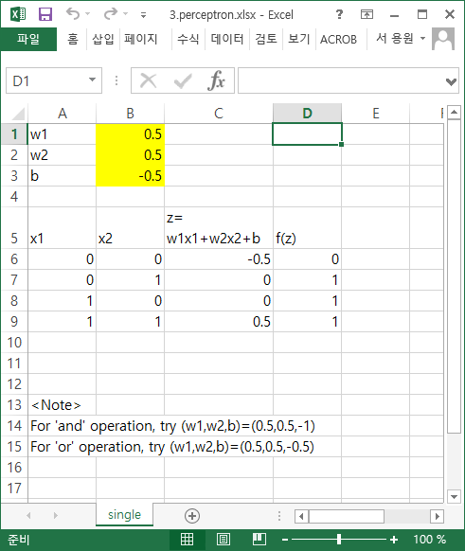

Slide 17
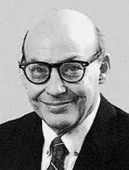

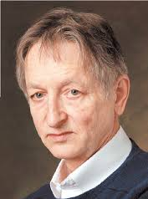
A short history
Marvin Minsky and Seymour Papert, Perceptrons(1969) proved single perceptros cannot fit nonlinear (like XOR) borders, and argued no way to train multilayered perceptrons
Almost all major fundings to NN research stopped afterwards
In 1974, Paul Werbos, a Ph.D. student in Harvard, discovered backpropagation algorithm to train multilayer neural networks, but ignored by academy
in 1986, Geoffrey Hinton, professor in CMU, rediscovered backpropagation, opened up new possibilities to connectionst approach to AI

Slide 18
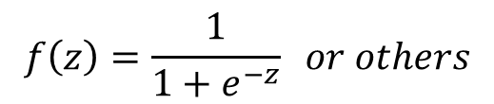

Modern single layer neural network (modified perceptron)
$$x_{1}$$
$$w_{1}$$
$$x_{2}$$
$$w_{2}$$
$$Σ$$
$$z$$
$$f(z)$$
$$a$$
$$w_{3}$$
$$x_{3}$$
$$f\left(z\right)=\frac{1}{1+e^{−z}} or others$$
…
$$b$$

Slide 19

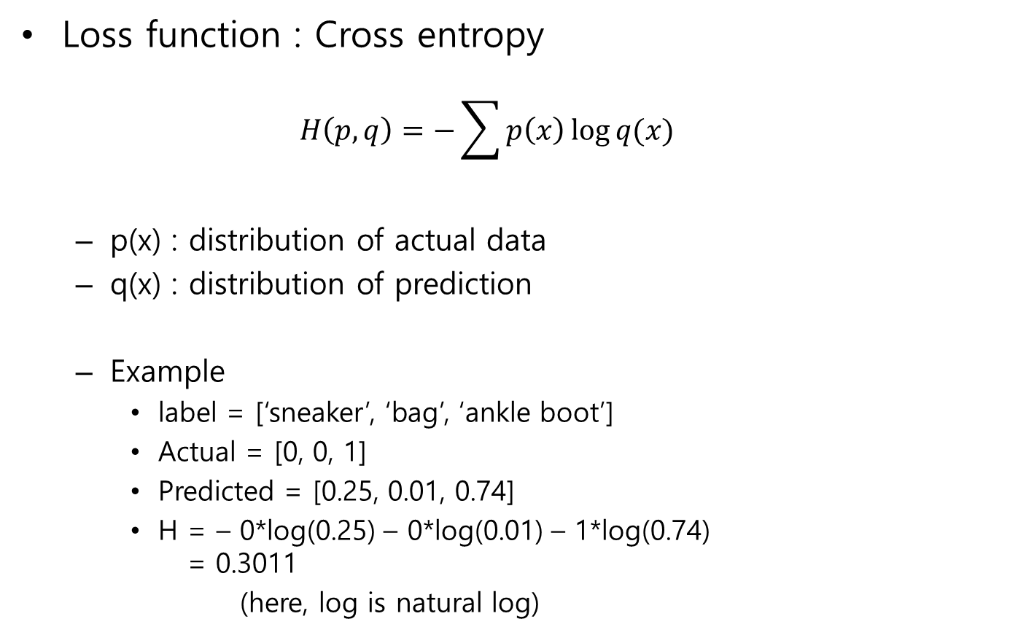
Backpropagation
Loss function : Cross entropy
$$H\left(p,q\right)=−\sum{p\left(x\right)\log{q(x)}}$$
p(x) : distribution of actual data
q(x) : distribution of prediction
Example
label = [‘sneaker’, ‘bag’, ‘ankle boot’]
Actual = [0, 0, 1]
Predicted = [0.25, 0.01, 0.74]
H = – 0*log(0.25) – 0*log(0.01) – 1*log(0.74) = 0.3011
(here, log is natural log)

Slide 20
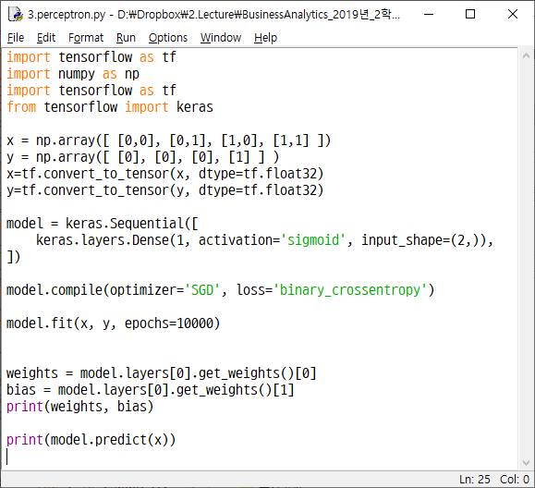

Slide 21



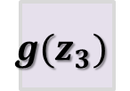

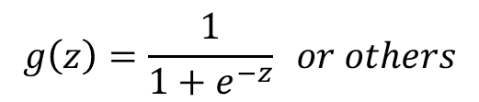


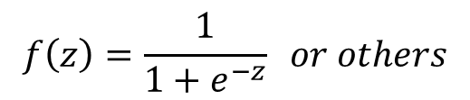

Modern multilayer neural network
$$b_{1}$$
$$g\left(z\right)=\frac{1}{1+e^{−z}} or others$$
$$x_{1}$$
$$w_{11}$$
$$w_{12}$$
$$Σ$$
$$z_{1}$$
$${f(z}_{1})$$
$$w_{13}$$
$$Σ$$
$$z_{3}$$
$${g(z}_{3})$$
$$a$$
$$w_{21}$$
$$w_{23}$$
$$Σ$$
$$z_{2}$$
$${f(z}_{1})$$
$$x_{2}$$
$$w_{22}$$
$$b_{3}$$
$$f\left(z\right)=\frac{1}{1+e^{−z}} or others$$
$$b_{2}$$

Slide 22
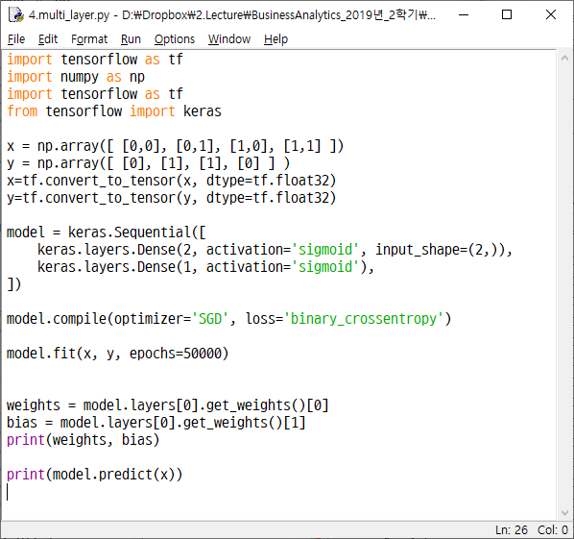

Slide 23
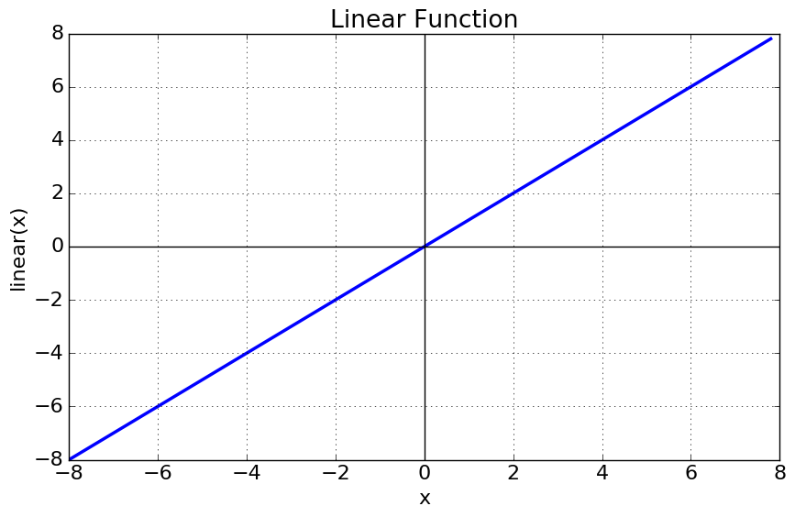
Activation functions
Linear function (activation=None)
f(x) = x
(-inf, inf) → (-inf, inf)
rarely used

Slide 24
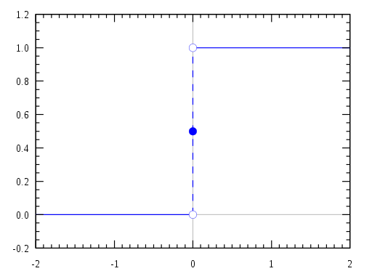
Activation functions
Step function
(-inf, inf) → 0 or 1
gradient based backpropagation algorithm cannot be applied

Slide 25
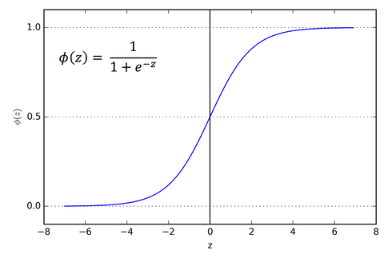
Activation functions
Sigmoid function (activation=‘sigmoid‘)
(-inf, inf) → (0, 1)
gradient vanishing problem
not centered
slow convergence

Slide 26
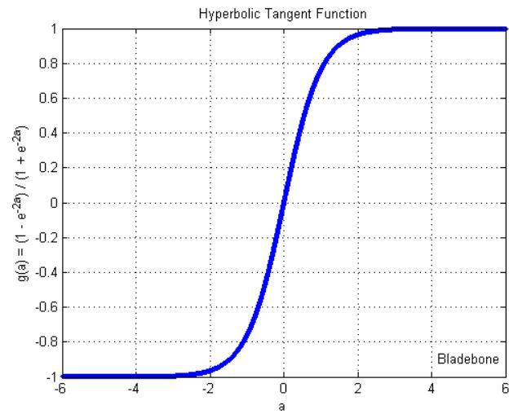
Activation functions
tanh (hyperbolic tangent) function (activation='tanh‘)
(-inf, inf) → (-1, 1)
centered
gradient vanishing problem
mainly used classification between two classes

Slide 27
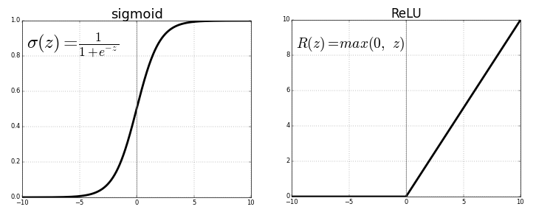
Activation functions
ReLU (Rectified Linear Unit) Activation Function (activation=‘relu‘)
(-inf, inf) → (0, inf)
fast and resolves gradient vanishing problem
most used activation function in the world right now

Slide 28
Activation functions
Softmax : To be continued

